Slide 1
Cockpit
Wing
Wing
Hull
Energy cores
Drone 1
Thruster

Slide 2
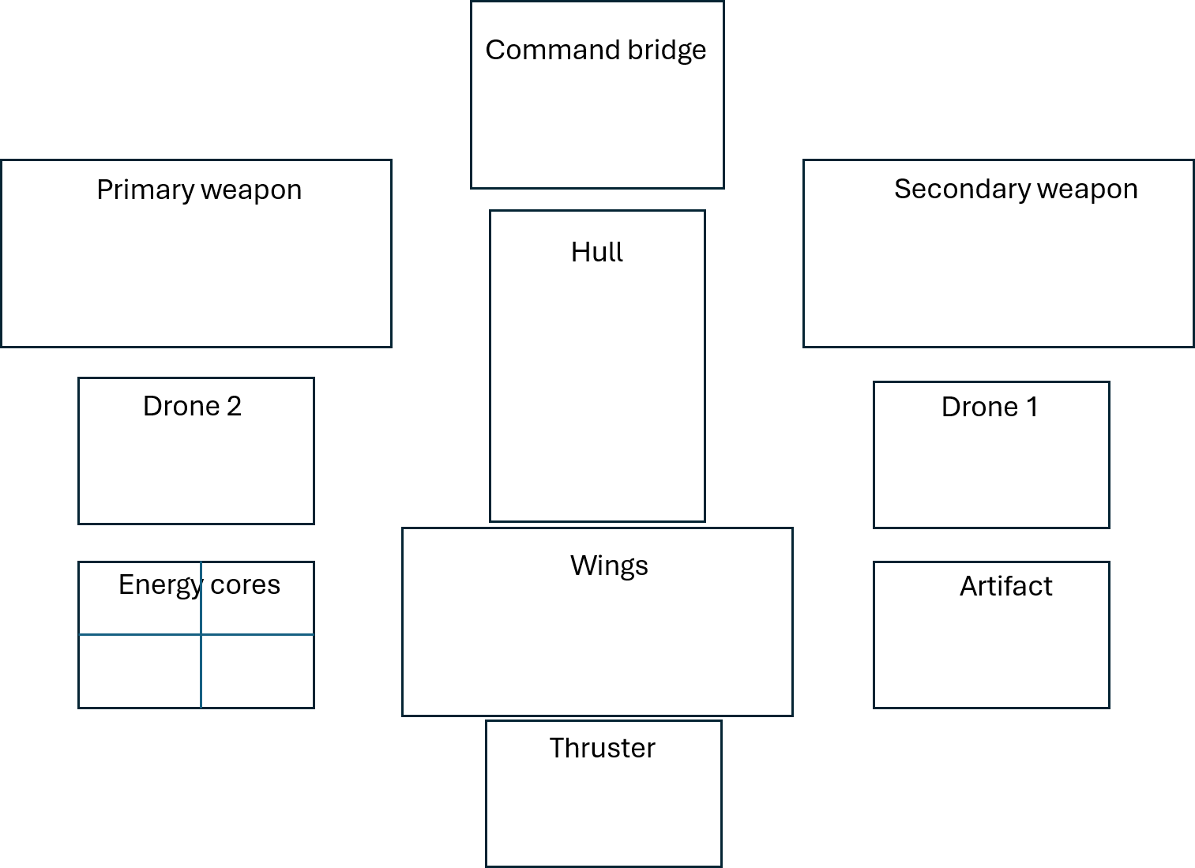

Slide 3
Item name 3
Stats
Selected item
HP
Fire rate
AOE
Armor pen %
Armor pen flat
All other stats that is global (not weapon tied
Item name 2
Option 1
Option 2
Option 3
General description, short and bold big font
General description, short and bold big font
Item name 1
General description, short and bold big font
Detailed explanation (if needs to, especially for key word effects like burn, bleed, electrocute, etc. Small light font in Italic
Detailed explanation (if needs to, especially for key word effects like burn, bleed, electrocute, etc. Small light font in Italic
Detailed explanation (if needs to, especially for key word effects like burn, bleed, electrocute, etc. Small light font in Italic

Slide 4
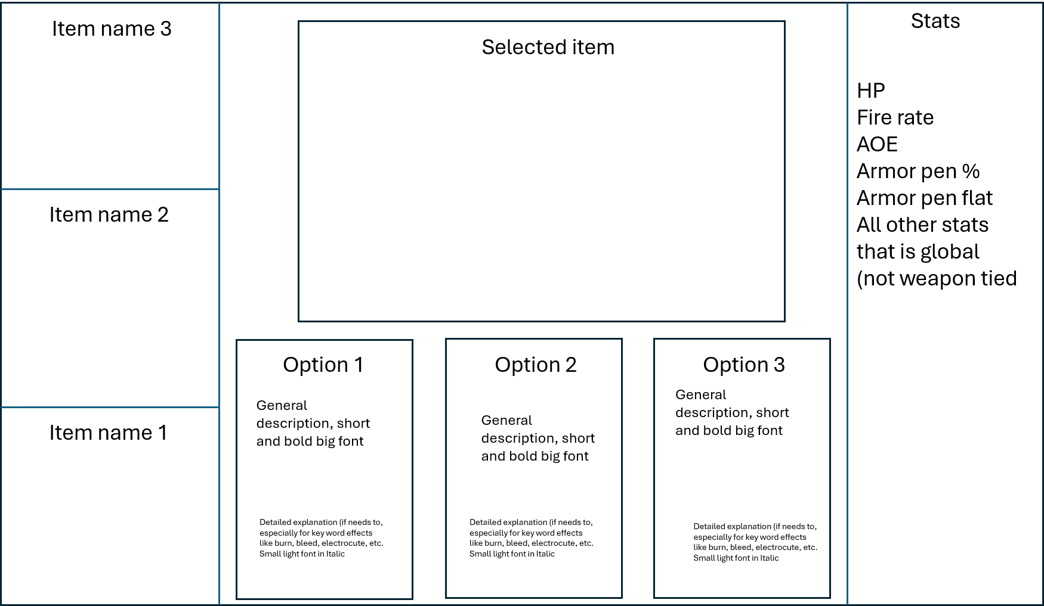

Slide 5
Boss HP and shield (mirror that of player, It will only shows up when there is a boss and will disappear when there is none
Weapons
Passive items
The outer layer is actually the shield, it will fill left to right with a shade of blue
The inside box is the HP, also fill left to right
Current shield / max shield
Current HP/ MaxHP

Slide 7
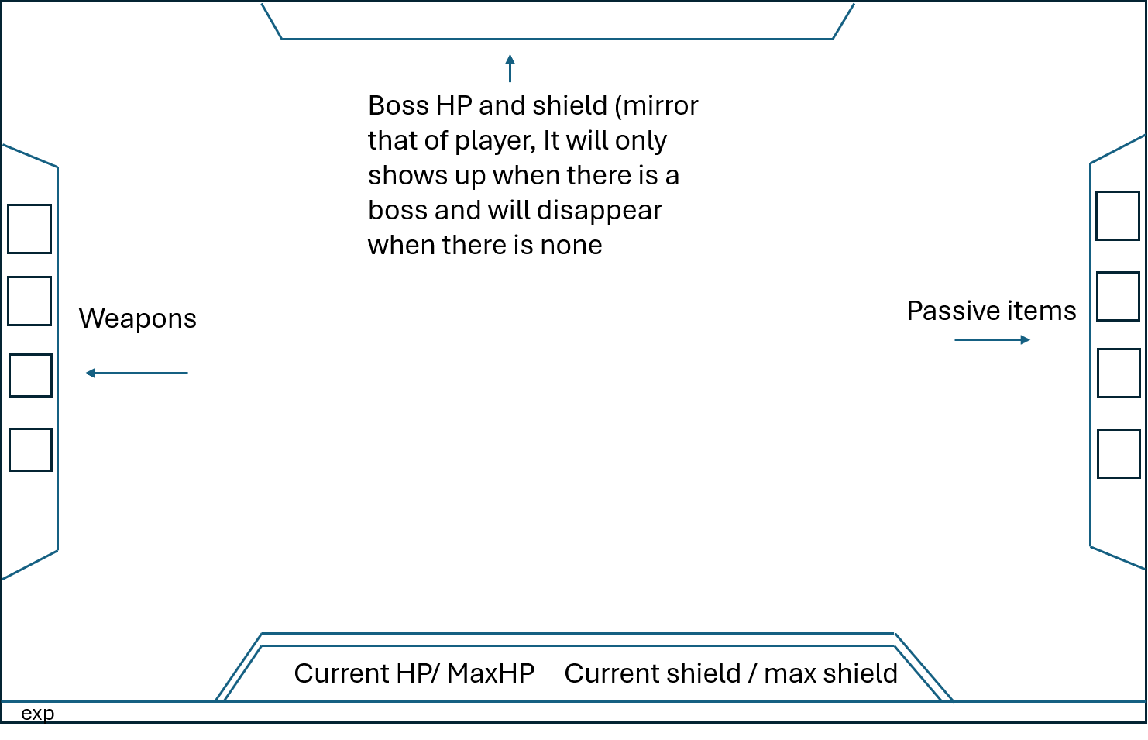
The outer layer is actually the shield, it will fill left to right with a shade of blue
The main box is the HP, also fill left to right

